Slide 1

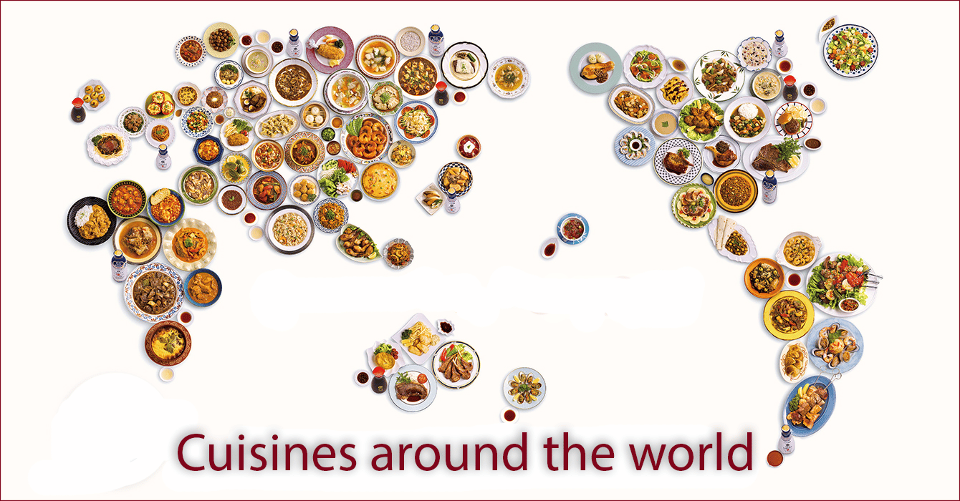
Data Mining Project
Yeşim Yalçın
200104004094

Slide 2
Contents
Project Explanation
Problem Solution
Enhancements to the Initial Solution
Results
Resources

Slide 3


Project Explanation
The project aims to determine which cuisine a given recipe belongs to. For this project, I found a dataset taken from Kaggle and Nature. An example of data objects in the dataset can be seen below:
SoutheastAsian,salt,cassava,margarine,coconut,milk
EastAsian,eggs,pork,soy_sauce,water,sugar,wine,soy_sauce,tofu_puffs
NorthAmerican,baking_powder,baking_soda,salt,butter,all_purpose_flour,sugar,butter milk
SoutheastAsian,silken_tofu,ginger,shallots,brown_sugar,cilantro,chili_paste,lemongras s,coconut,vegetable,soy_sauce,lime,crimini_mushrooms

Slide 4
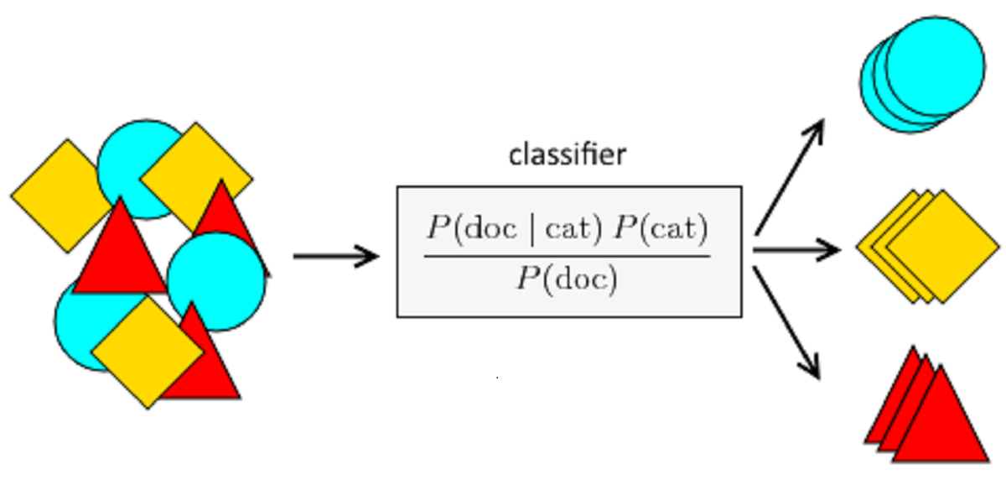
I chose naive bayes classification as my method of solution. The reason why I chose naive bayes method was the fact that the dataset is already properly labeled, naive bayes is believed to give good results with big datasets and it does not have a very complicated implementation.
I needed to minimize the class imbalance as much as possible for the best results. Therefore, I used these methods one by one to get more accurate results:
Undersampling
Data Augmentation
Zero Probability Fix
Stratified Cross Validation & Bagging
Boosting

Slide 5
I applied the methods one by one and recalculated the results to see how useful they were.
The initial training set results are from using naive bayes directly on the given dataset. It is expected to have bad individual accuracies and bad recall scores for the imbalanced classes.
In the end it is expected to get a better accuracy compared to the initial accuracy. Moreover, the individual accuracies & recalls for the imbalanced classes must be improved a lot.

Slide 6
Problem Solution
I started with preprocessing the data. Some rows had the same ingredients included multiple times, some rows had only one ingredient written. I started with detecting and removing those rows.
Afterwards, I needed to reshape the dataset in a way that I could use classification on it. I reshaped it in a way like below:
In the end, I created the training and test sets.
Cuisine,chicken,cinnamon,soy_sauce,onion,ginger,cane_molasses,cumin,garlic…
African,1,1,1,1,1,0,0,0,0,0,0,0,0,0,0,0,0,0,0,0,0,0,0,0,0,0…

Slide 7
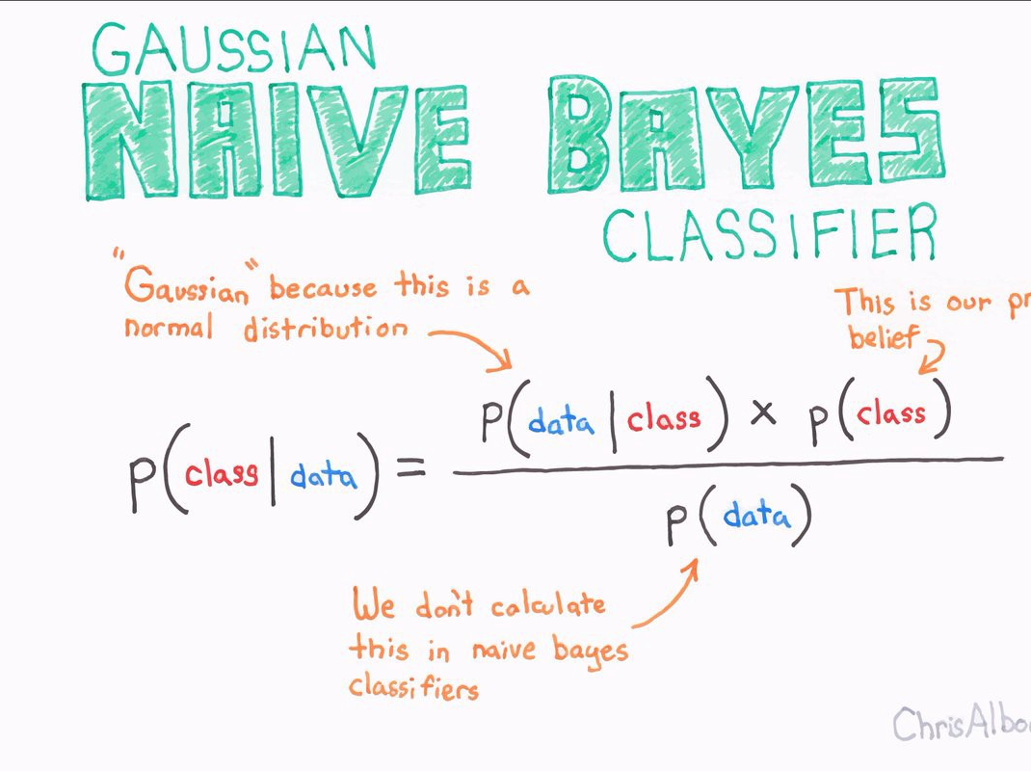
To implement the classification, I needed to calculate the probability of each class P(C). Afterwards, I needed to calculate the probabilty of each ingredient for each class P(I|C). Multiplying those two values gave me the probability of an ingredient belonging to the class P(C|I). After calculating all the probabilities, I saved them in a file.
For a given recipe, it’s probability to belong to each cuisine is looked from the trainResults.csv file. The cuisine with the highest probability is selected as the result.

Slide 8
Enhancements to the Initial Solution
Undersampling to fix class Imbalance
I used random undersampling on the classes EastAsian, SouthAsian, SoutheastAsian and WeasternEuropean becuase they had a lot more samples compared to other cuisines. Moreover, I wanted this process to be as random as possible not to have a bias in the results. To achieve that, I used a randomizer function randrange.

Slide 9

Oversampling to Fix Class Imbalance
I used a data augmentation method on the classes African, MiddleEastern and NorthernEuropean because they had a lot less samples compared to other cuisines.
To implement the data augmentation method, I counted what ingredients are used how many times in each of these classes. Afterwards with the found ingredients and count weights, I created new augmented recipes randomly using numpy.random.choice() function.

Slide 10
Zero Probabilty Fix
There is a possibilty that there can be a recipe with ingredient X belonging to cuisine A. However, that ingredient might never be found in any of cuisine A recipes in the training set. In a situation like that, that recipe will always be put in a wrong class. To fix that during training, I never set a possibility as 0. Instead I gave them some very low values depending on the classes.

Slide 11
Cross Validation
For the previous methos, the data were randomly chosen each time for training and testing. However, this resulted in bias. To have even better results, I decided to create my model with cross validation instead.
This enabled me to use bagging with 10 different trained models. To have some distinction in models, I made sure each model had different test sets and rest as their training sets.
Moreover, I created the sets with stratified cross validation. To create a set, same amount of recipes are taken from each cuisine (considering percentages).

Slide 12
Boosting
Lastly, I thought about using boosting for the 10 different trained models of cross validation. I gave different weights to each models while combining them according to their train set result accuracies.

Slide 13

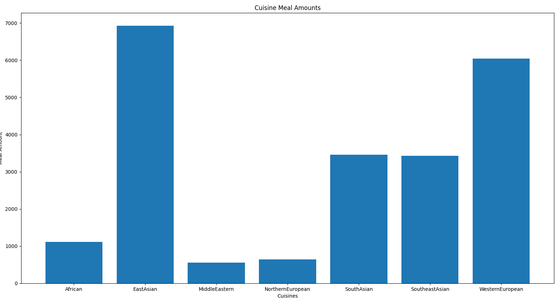
Results
Initial Results
The initial results did have below average accuracy but the recall values of individual classes suffered a lot.

Slide 14
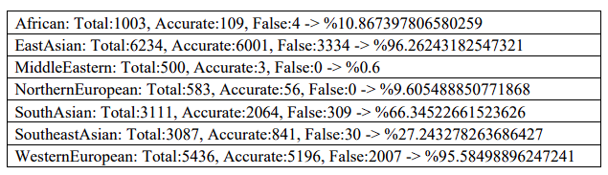
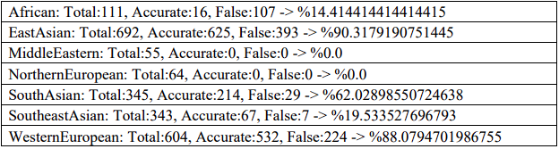
TrainSet:
Accurate: 14270, False: 5684 -> %71.51448331161671
TestSet:
Accurate: 1454, False: 760 -> %65.67299006323395

Slide 15
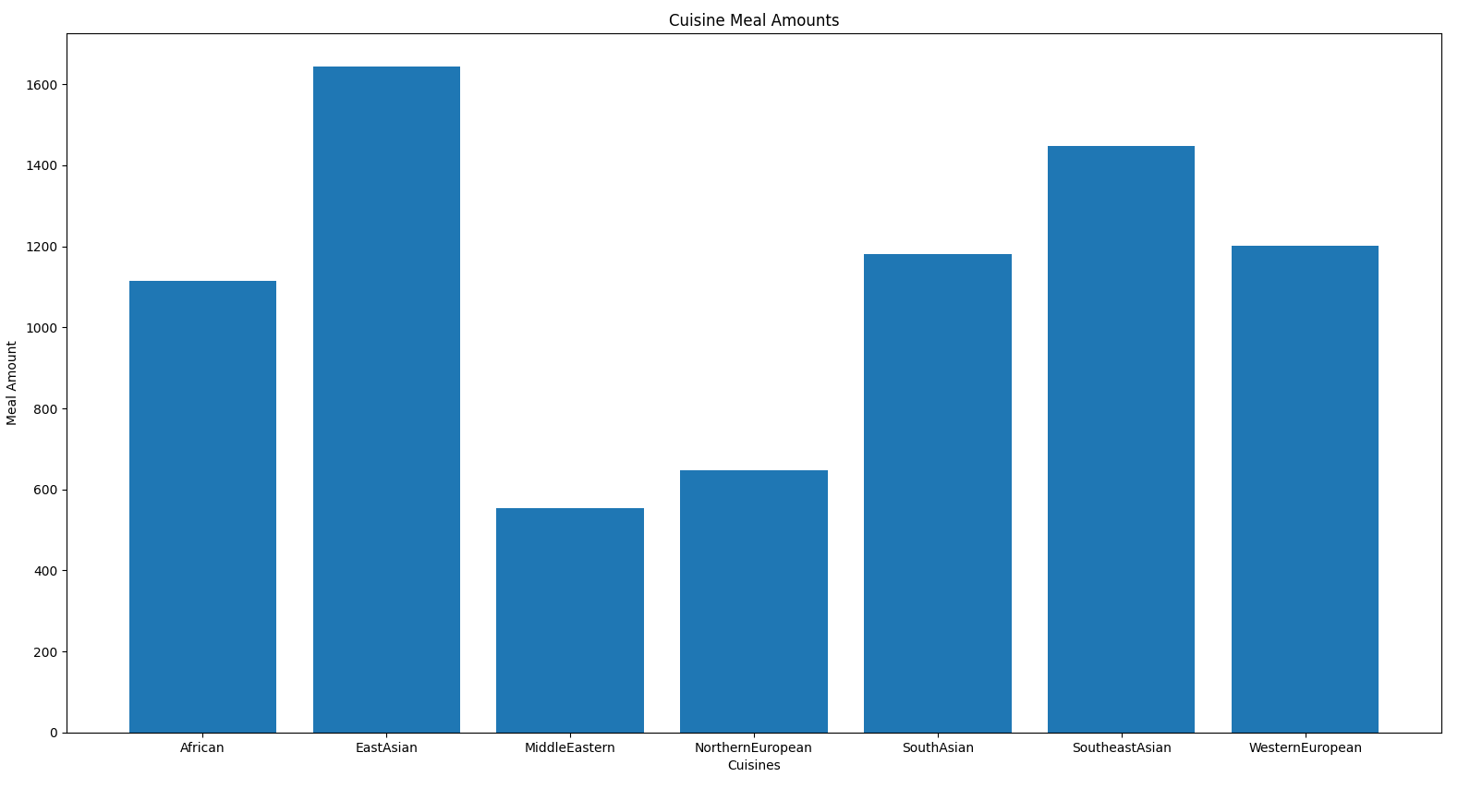
Undersampled Results
Random undersampling had positive effect both on training set overall accuracy and imbalanced classes percentages. However, there is still a big imbalance

Slide 16
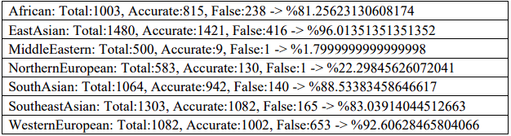
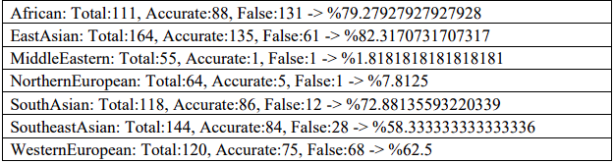
TrainSet:
Accurate: 5401, False: 1614 -> %76.99215965787599
TestSet:
Accurate: 474, False: 302 -> %61.08247422680413

Slide 17
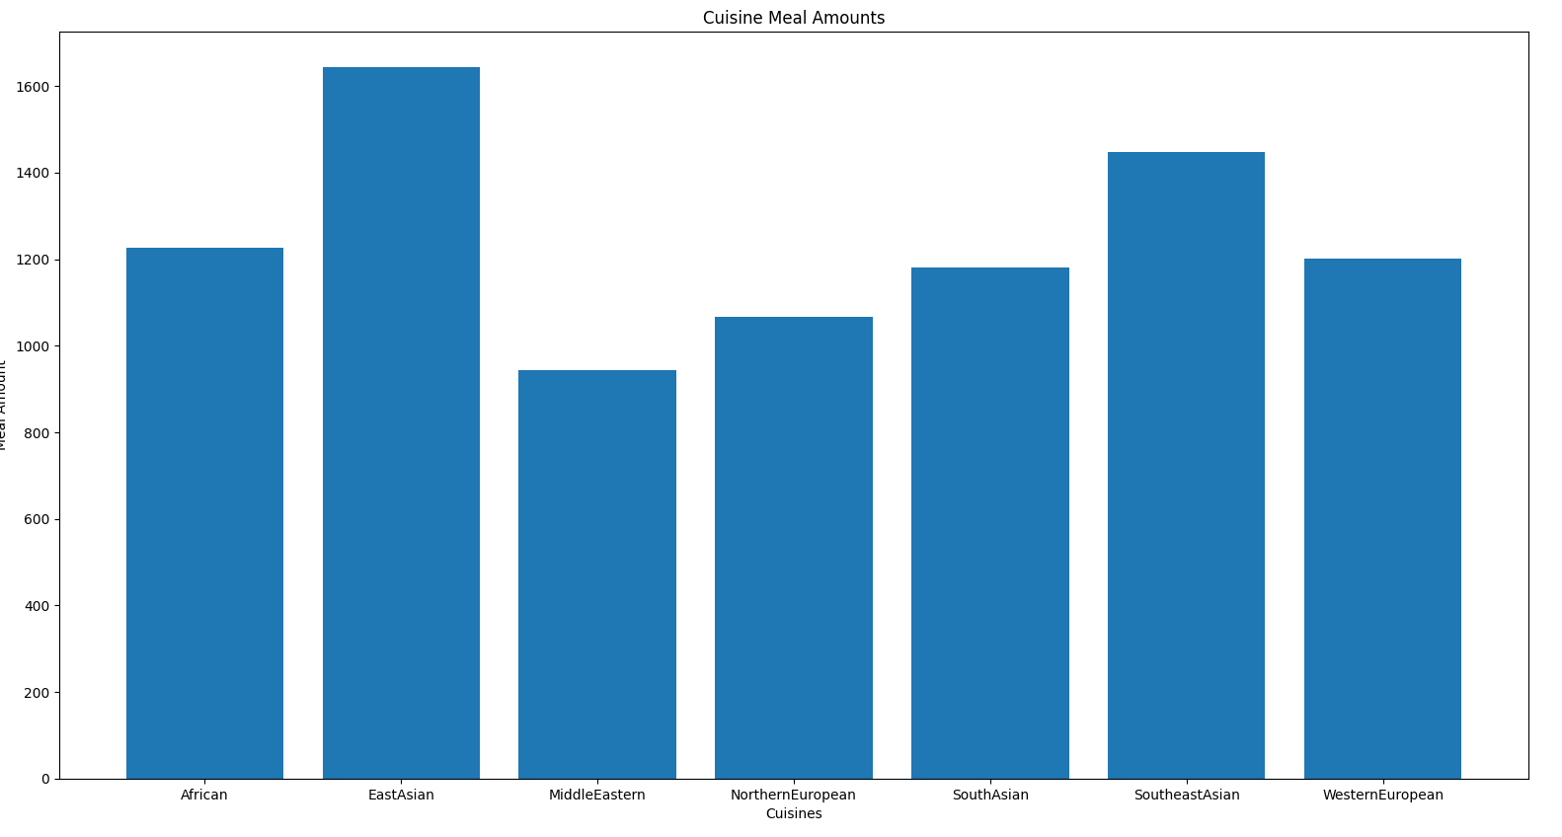
Oversampled Results
Data augmentation helped to fix the class imbalance very well. Both the training set overall accuracy and class accuracies improved significantly.

Slide 18
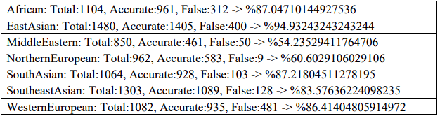
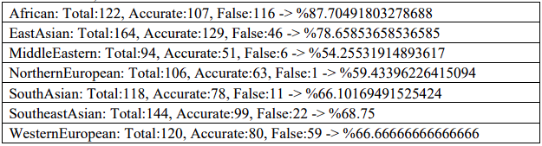
TrainSet:
Accurate: 6362, False: 1483 -> %81.09623964308477
TestSet:
Accurate: 607, False: 261 -> %69.93087557603687

Slide 19
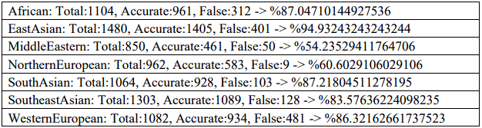
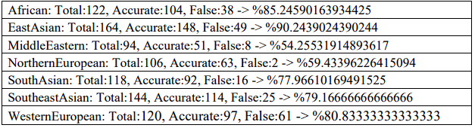
Zero Probability Fixed Results
The main aim of the zero probability fix is to have better test set result. It can be seen that the test set accuracies improved significantly. However, it did not contribute into fixing class imbalance.
TrainSet: TestSet:
Accurate: 6361, False: 1484 Accurate: 669, False: 199
-> %81.08349267049076 -> %77.07373271889401

Slide 20
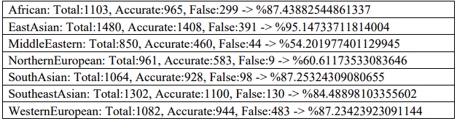
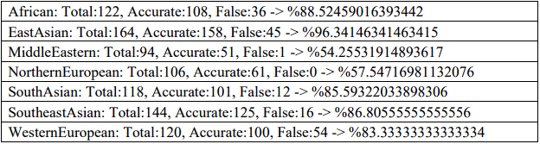
Cross Validation Results
From the results we can see that cross validation removed any possible bias during training therefore increased the test set accuracies.
TrainSet: TestSet:
Accurate: 6388, False: 1454 Accurate: 704, False: 164
-> %81.46065266460079 -> %81.10599078341014

Slide 21
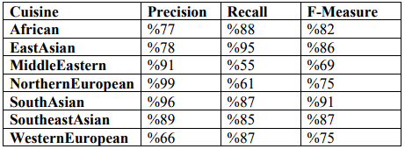
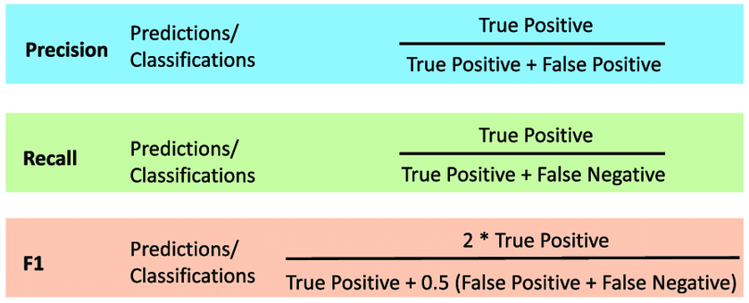
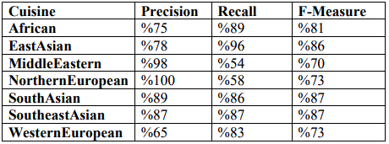
TrainSet:
Final Analysis on the Results
Because boosting did not give me the desired effects I used the Cross Validation results for final analysis.
The first methods fixed the class imbalance and the later ones improved the test set results.
TestSet:

Slide 22
Resources
A. Dataset:
https://raw.githubusercontent.com/warcraft12321/HyperFoods/master/data/kaggl e_and_nature/kaggle_and_nature.csv
B. Dataset Research:
https://towardsdatascience.com/recipe-cuisine-classification-278ea0837c94
C. Data Mining Techniques & Evaluation Metrics:
https://hanj.cs.illinois.edu/bk3/bk3_slidesindex.htm

